Slide 1

HEAP TREE

Slide 2
Contents
Definition of Heap
Heap Tree & Types
  Max Heap Tree
  Min Heap Tree
Construction of Max Heap Tree with Example
Construction of Min Heap Tree with Example

Slide 3
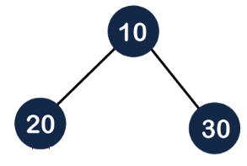
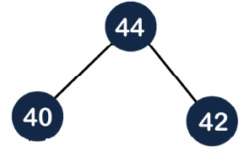
HEAP
A heap is defined as complete binary tree of ‘n’ nodes such that the value of each node is either less than or equal to OR greater than or equal to the value of parent node.
Heap is a special case of balanced binary tree data structure where the parent-node key is compared with its children and arranged accordingly. If α has child node β then −
  key(α) >= key(β) or
  key(α) <= key(β)

Slide 4
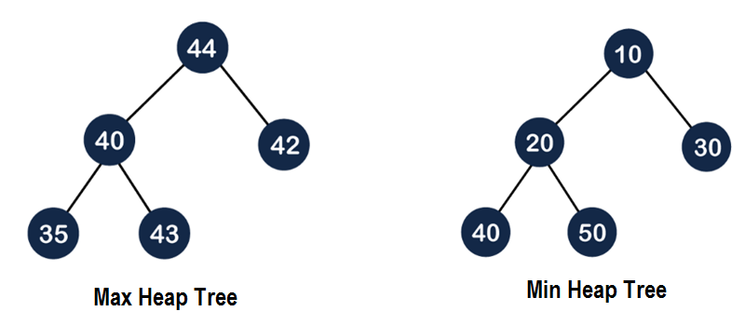
Heap Tree
A heap tree is defined as complete binary tree of ‘n’ nodes, where path from root node to terminal node forms an ordered list.
There are two types of heap trees:
  Max Heap Tree / Descending Heap Tree
  Min Heap Tree / Ascending Heap Tree

Slide 5
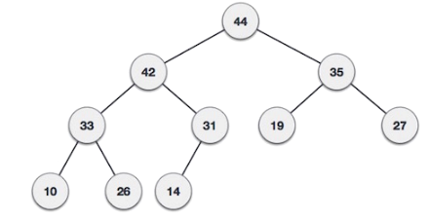
Max Heap Tree
Here the path from root node to a terminal nodes forms an ordered list of elements arranged in descending order.
So, here root node has the largest key value.

Slide 6
Max Heap Construction: Algorithm
We are going to derive an algorithm for max heap by inserting one element at a time.
At any point of time, heap must maintain its property. While insertion, we also assume that we are inserting a node in an already heapified tree.
Algorithm:
Step 1 − Create a new node at the end of heap.
Step 2 − Assign new value to the node.
Step 3 − Compare the value of this child node with its parent.
Step 4 − If value of parent is less than child, then swap them.
Step 5 − Repeat step 3 & 4 until Heap property holds.

Slide 7
Max Heap Construction : Example
Q) Create a Max Heap tree using the following sequence of input values:
44, 33, 77, 11, 55, 88, 66
Solution:
To create the max heap tree, we need to consider the following two cases:
First, we have to insert the element in such a way that the property of the complete binary tree must be maintained.
Secondly, the value of the parent node should be greater than the either of its child.

Slide 8

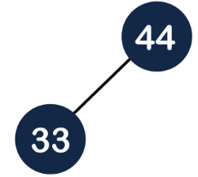
Max Heap Construction : Example
Step 1: First we add the 44 element in the tree as shown below:
Step 2: The next element is 33. As we know that insertion in the binary tree always starts from the left side so 33 will be added at the left of 44 as shown below:

Slide 9
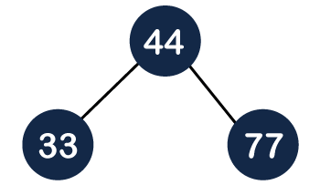
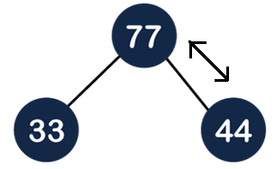
Max Heap Construction : Example
Step 3: The next element is 77 and it will be added to the right of the 44 as shown below:
As we can observe in the above tree that it does not satisfy the max heap property, i.e., parent node 44 is less than the child 77. So, we will swap these two values as shown below:

Slide 10
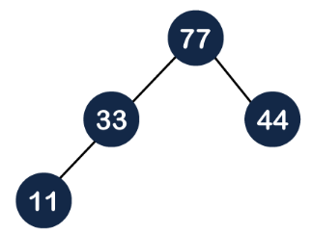
Max Heap Construction : Example
Step 4: The next element is 11. The node 11 is added to the left of 33 as shown below:

Slide 11
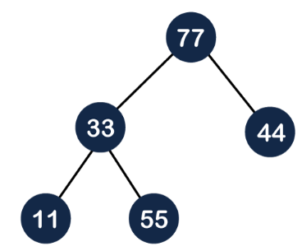
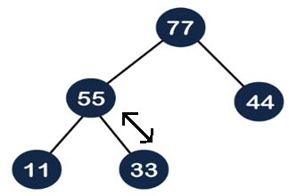
Max Heap Construction : Example
Step 5: The next element is 55. To make it a complete binary tree, we will add the node 55 to the right of 33 as shown below:
As we can observe in the above figure that it does not satisfy the property of the max heap because 33<55, so we will swap these two values as shown below:

Slide 12
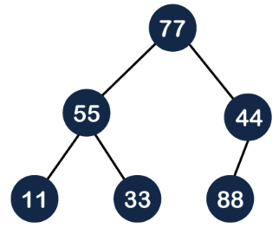
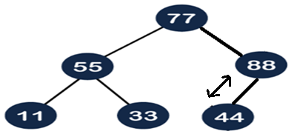
Max Heap Construction : Example
Step 6: The next element is 88. The left sub-tree is completed so we will add 88 to the left of 44 as shown below:
As we can observe in the above figure that it does not satisfy the property of the max heap because 44<88, so we will swap these two values as shown below:

Slide 13
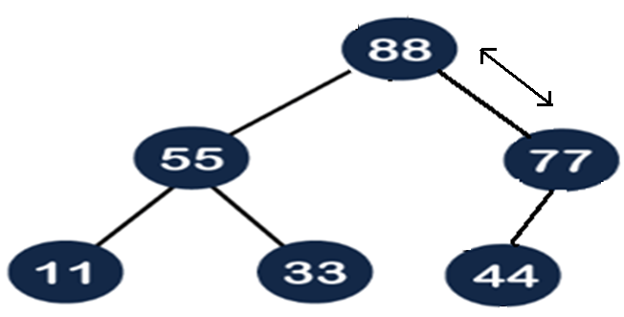
Max Heap Construction : Example
Again, it is violating the max heap property because 88>77 so we will swap these two values as shown below:

Slide 14
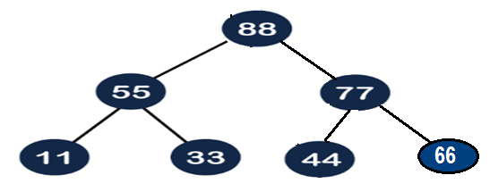
Max Heap Construction : Example
Step 7: The next element is 66. To make a complete binary tree, we will add the 66 element to the right side of 77 as shown below:

Slide 15
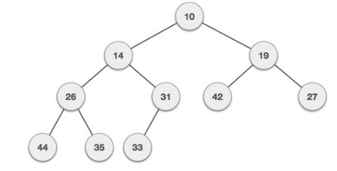
Min Heap Tree
Here the path from root node to a terminal nodes forms an ordered list of elements arranged in ascending order.
So, here root node has the smallest key value.

Slide 16
Min Heap Construction: Algorithm
We are going to derive an algorithm for min heap by inserting one element at a time.
At any point of time, heap must maintain its property. While insertion, we also assume that we are inserting a node in an already heapified tree.
Algorithm:
Step 1 − Create a new node at the end of heap.
Step 2 − Assign new value to the node.
Step 3 − Compare the value of this child node with its parent.
Step 4 − If value of parent is larger than child, then swap them.
Step 5 − Repeat step 3 & 4 until Heap property holds.

Slide 17
Min Heap Construction : Example
Q) Create a Max Heap tree using the following sequence of input values:
44, 33, 77, 11, 55, 88, 66
Solution:
To create the min heap tree, we need to consider the following two cases:
First, we have to insert the element in such a way that the property of the complete binary tree must be maintained.
Secondly, the value of the parent node should be smaller than the either of its child.

Slide 18
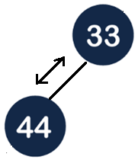
Min Heap Construction : Example
Step 1: First we add the 44 element in the tree as shown below:
Step 2: The next element is 33. As we know that insertion in the binary tree always starts from the left side so 33 will be added at the left of 44 as shown below:

Slide 19
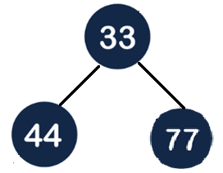
Max Heap Construction : Example
Step 3: The next element is 77 and it will be added to the right of the 33 as shown below:

Slide 20
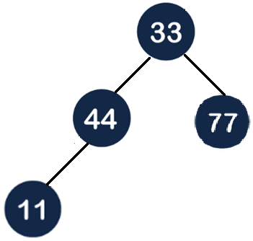
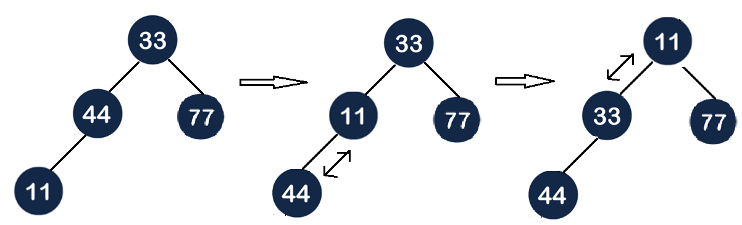
Min Heap Construction : Example
Step 4: The next element is 11. The node 11 is added to the left of 44 as shown below:

Slide 21
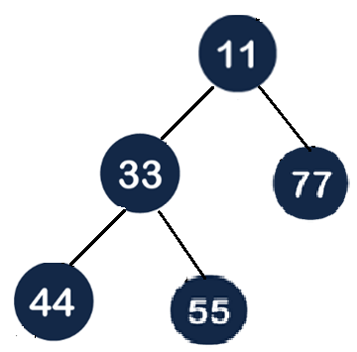
Min Heap Construction : Example
Step 5: The next element is 55. To make it a complete binary tree, we will add the node 55 to the right of 33 as shown below:

Slide 22
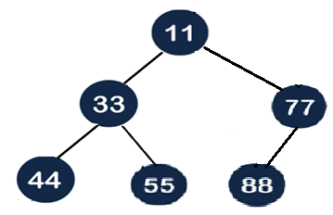
Min Heap Construction : Example
Step 6: The next element is 88. The left sub-tree is completed so we will add 88 to the left of 77 as shown below:

Slide 23
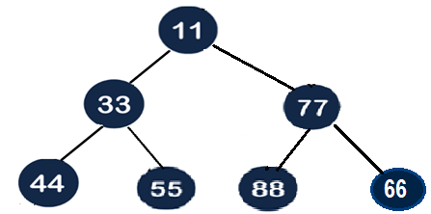
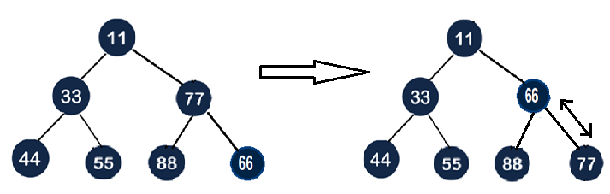
Min Heap Construction : Example
Step 7: The next element is 66. To make a complete binary tree, we will add the 66 element to the right side of 77 as shown below:

Slide 24
THANK YOU

